Slide 1

A DEEP LEARNING-BASED APPROACH FOR EXTRACTION OF INFORMATION FROM ELECTRONIC HEALTH RECORDS
By
Fatima Masood
ID: MSSE71F23S006
Supervised by
Dr. Muhammad Summair Raza
Co-Supervised by
Dr. Muhammad Ramzan Malik
Department of Software Engineering, Faculty of Computing and Information Technology, University of Sargodha, Pakistan

Slide 2

PRESENTATION ONLINE
INTRODUCTION
MOTIVATION
RESEARCH OBJECTIVES & CONTRIBUTION
RELATED WORK AND LITERATURE REVIEW
GAPS
PROBLEM STATEMENT
RESEARCH QUESTIONS
DATASET DECSRIPTION AND PRE PROCESSING
MODEL DESIGN (METHODOLOGY)
RESULTS AND EVALUATION
DISCUSSION
CONCLUSION
FUTURE WORK

Slide 3
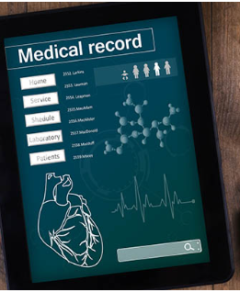
Introduction
ELECTRONIC HEALTH RECORDS (EHRs):
Digital records of a patient’s health information
INFORMATION EXTRACTION:
An NLP process that automatically pulls meaningful information from unstructured text.

Slide 4

Introduction
This Research:
Addresses the challenge of extracting structured medical data from unstructured Electronic Health Records (EHRs).
Proposes a deep learning framework combining a BiLSTM-based Named Entity Recognition model with a Runtime Context Identifier for real-time entity extraction.
Aims to enhance clinical decision support by enabling precise and efficient medical information retrieval.

Slide 5

Motivation
EHRs are exploding in volume and projected to reach 2,300+ exabytes by 2025, with about 80% stored as unstructured text. [1]
Critical clinical information is hidden in free-text, causing delays; clinicians spend about 35% of their time navigating records. [2]
Manual data extraction is slow and costly.

Slide 6

Motivation
Healthcare needs automated, scalable solutions to process millions of clinical notes generated daily.
Deep learning models outperform traditional NLP, improving extraction accuracy by 10–25%. [3]
Better extraction enhances clinical decisions, reducing adverse and improving diagnosis accuracy.

Slide 7

Research Objectives
To find out the deficiencies of the existing approaches
To develop an automated approach for structured information extraction from EHRs by overcoming the deficiencies of existing approaches.
To validate the proposed approach in terms of accuracy and efficiency using different case studies.

Slide 8

Related Work and Literature Review
Previous works include QA pipelines, BERT, and BiLSTM models for clinical entity extraction.
Challenges involve data variability, model interpretation, and handling linguistic complexity.
Unlike prior methods, We integrate a BiLSTM-NER with a Runtime Context Identifier to achieve robust multi-label entity extraction and runtime prediction, addressing gaps in precision and applicability to diverse datasets.

Slide 9
Related Work and Literature Review
Paper | Methodology | Gaps
[4] | QA techniques for extraction of information from EHRs | Addressing diverse question types and constrained answer options in EHR extraction.
[5] | Information extraction schema for entities and relationships from radiology reports using the development of RedGraph. | 1- The schema employed does not reflect information on clinical context in radiology reports, except for some parameters. 2- Cases of ambiguity in reports.
[6] | Use of BERT models on unexplained radiology reports and labeled reading comprehension datasets, and proceeding with pre-training on radiology data sets and a medical encyclopedia. | The challenge of comparing reports from various radiologists due to different styles and word choices.

Slide 10
Paper | Methodology | Gaps
[7] | Created an open-source pipeline based on a locally deployed Large Language Model (LLM), named it Llama 2, to extract quantitative data from clinical text. | LLMs' decisions are based on probabilities rather than clear identifiers for certain tasks, leading to potential biases.
[8] | MetaMap and clinician annotations were applied on MIMIC-III nursing notes, evaluated by LLMs and fine-tuned models, with performance assessed through qualitative review and statistical analysis. | Using single-center data may limit generalizability to other centers.
[9] | Developing a framework to create a set of SDOH categories based on existing taxonomies and expert input then Evaluating three deep learning models: CNN, BiLSTM, and BERT-based Trained models on a manually annotated dataset of over 3,000 clinical notes. | 1- Limited to a single healthcare system. 2- Validation across different clinical settings is needed to assess the generalizability of the approach.

Slide 11
Paper | Methodology | Gaps
[10] | Utilizes local-global memory neural networks (based on LSTM) for mortality prediction by learning both individual patient patterns (local memory) and global disease evidence (global memory) from ICU data. | 1- Lack of model interpretability (black-box nature). 2- Limited insight into decision rationale reduces clinical trust.
[11] | Applies RNNs (specifically GRUs) on time-series EHR data from over 36,000 surgical inpatients to detect bacteremia; data sourced from ICU and general wards. | 1- Model opacity makes it difficult to understand prediction logic. 2- Limited to data from a single hospital, affecting generalizability.
[12] | Implements a transformer-based hierarchical attention network incorporating temporal information from EHRs to enhance risk prediction accuracy across three real-world datasets. | 1- Struggles with irregularities in EHR documentation. 2- Lack of model explainability; decision-making process remains opaque.

Slide 12

Gaps in Existing Literature
EHRs contain massive, critical clinical information, but over 80% is unstructured, making automated processing difficult.
Manual extraction is slow, costly, and no longer scalable.
Conventional machine learning models fail to capture context, leading to poor accuracy.

Slide 13

Gaps in Existing Literature
Traditional IE methods (rule-based, keyword search, basic NLP) struggle with:
complex medical terminology and abbreviations,
inconsistent clinical documentation across institutions,
high dependency on expert-crafted rules and large annotated datasets.

Slide 14
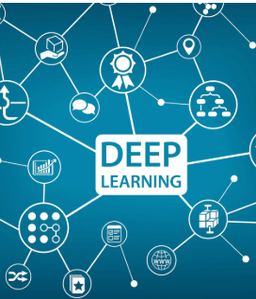
Problem Statement
Electronic Health Records (EHRs) contain large amounts of critical clinical information, most of which exists as unstructured text. Extracting meaningful data from these free-text notes using traditional manual or rule-based methods is slow, error-prone, and not scalable. There is a need for an automated, accurate information extraction approach to convert unstructured EHR text into structured, usable clinical data.

Slide 15

Research Questions
RQ1:
How can we automatically extract clinical information from electronic health records using deep learning?
RQ2 :
How the proposed approach can outperform the existing methods in terms of F1-Score, precision, and recall?

Slide 16

02
Methodology

Slide 17
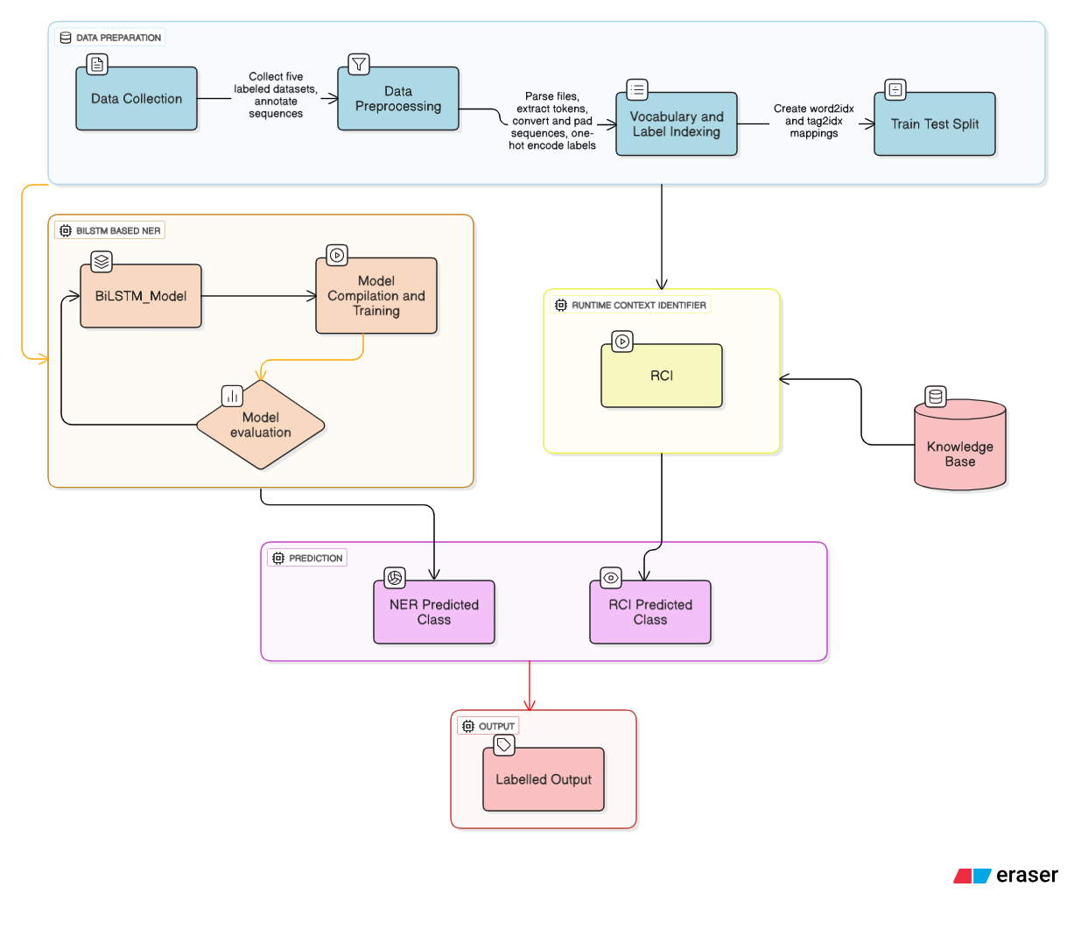
Methodology

Slide 18
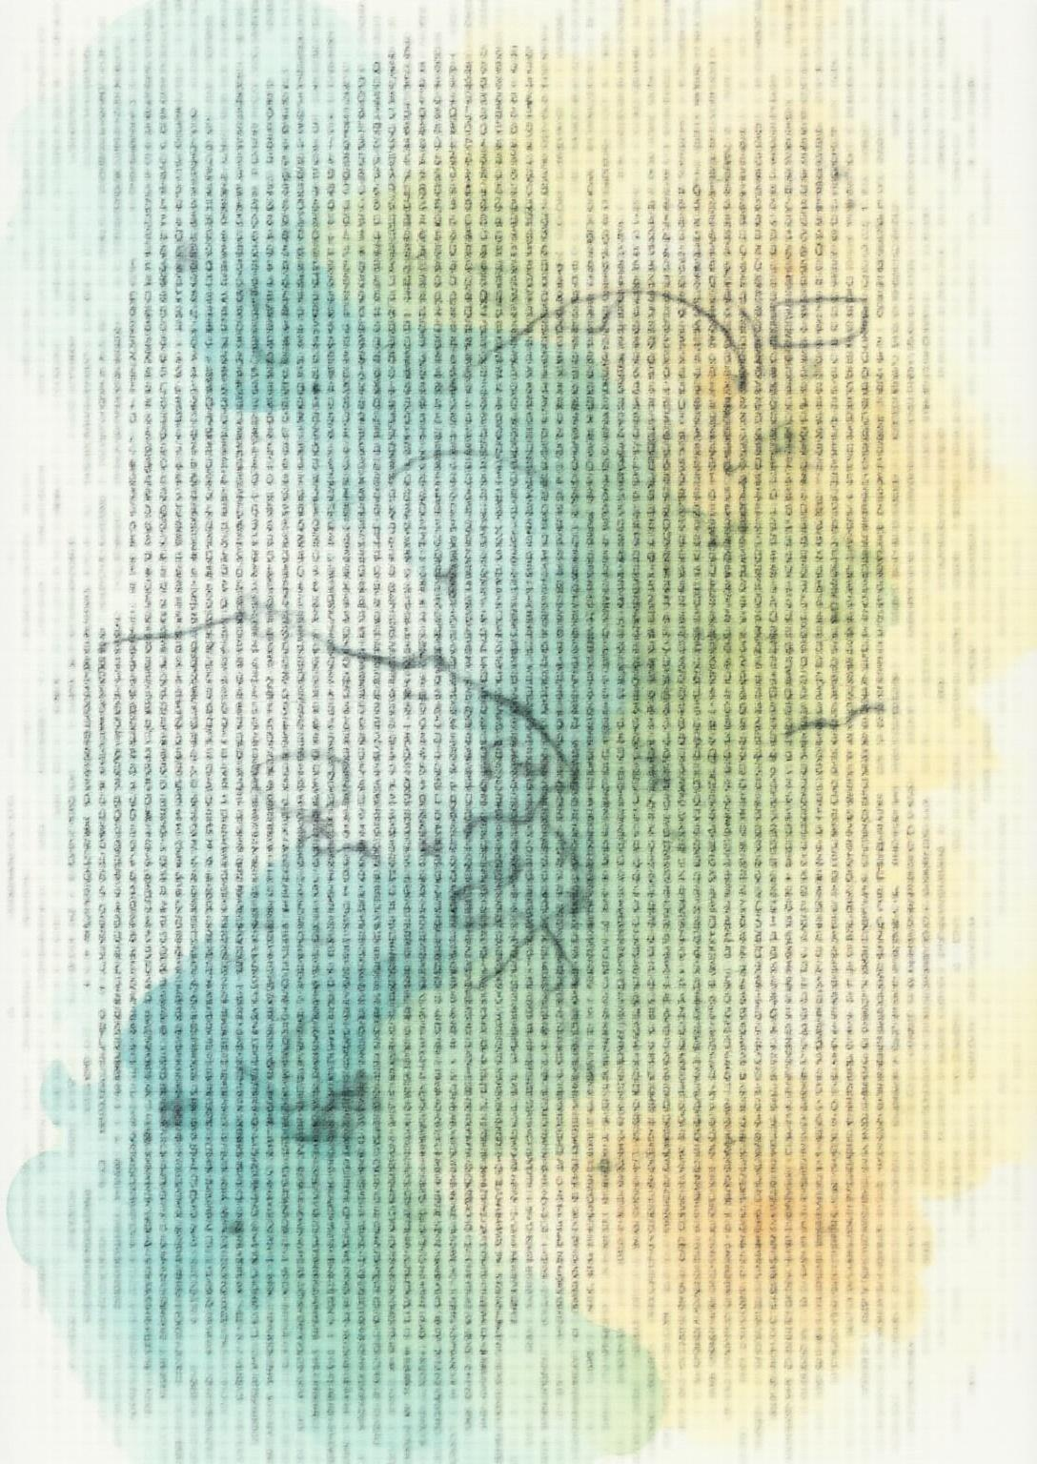
Dataset Description and Preprocessing
Medical Text for Text Classification : https://www.kaggle.com/datasets/chaitanyakck/medical-text
We split the dataset into five parts and labeled them as Dataset1, Dataset2, Dataset3, Dataset4, and Dataset5.
Annotated with multiple medical entity types like TEST, TREATMENT, SYMPTOM, CONDITION, and PROBLEM.
Datasets were split 80/20 for training and testing.

Slide 19
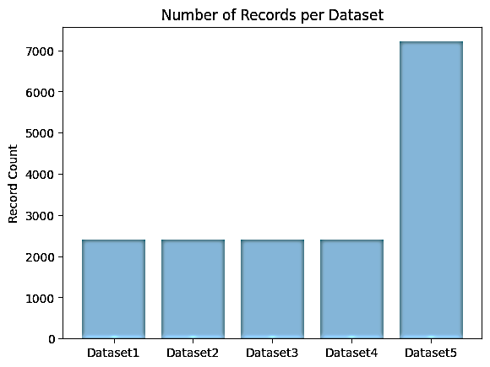
Dataset Records
Number of Records per Dataset.

Slide 20
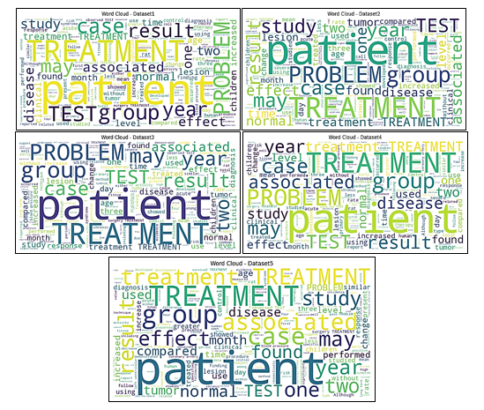
Dataset Description and Preprocessing
Preprocessing tasks included:
Tokenization
Stopword removal
Normalization
Stemming
Lemmatization
Sequence padding
Feature encoding.

Slide 21
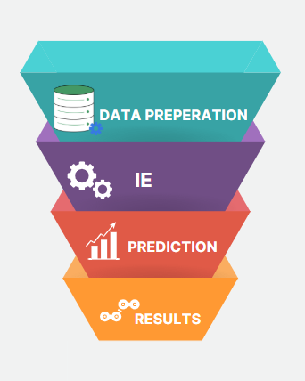
Model Design
The methodology comprises four phases:
Data Preparation
Information Extraction
Prediction
Results.

Slide 22
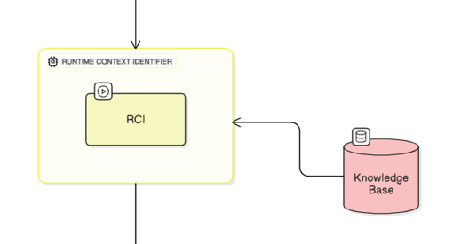
BiLSTM-based NER and Runtime Context Identifier
The BiLSTM-based NER model classifies medical entities using trained sequence models.
The RCI supplements this.
It detects the patterns that the NER model might miss.

Slide 23
Runtime Context Identifier
RCI is a rule-based medical knowledge engine supporting the NER model
Provides real-time, context-aware identification of medical entities
Handles new rules dynamically at runtime
Extracts information for diseases, symptoms, tests, and treatments
Works independently of NER model training constraints

Slide 24
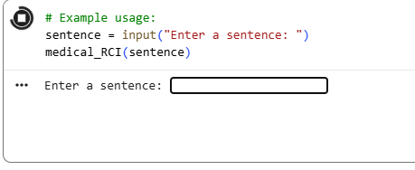
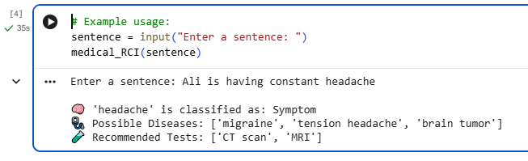
Runtime Context Identifier Working
Run-time deployment allows the user to enter a sentence at runtime.
RCI detects the word and provides its details.

Slide 25
Experimental Results
Evaluated on five datasets, the model achieved an average
F1-Score of 0.921
precision of 0.932
recall of 0.921.

Slide 26
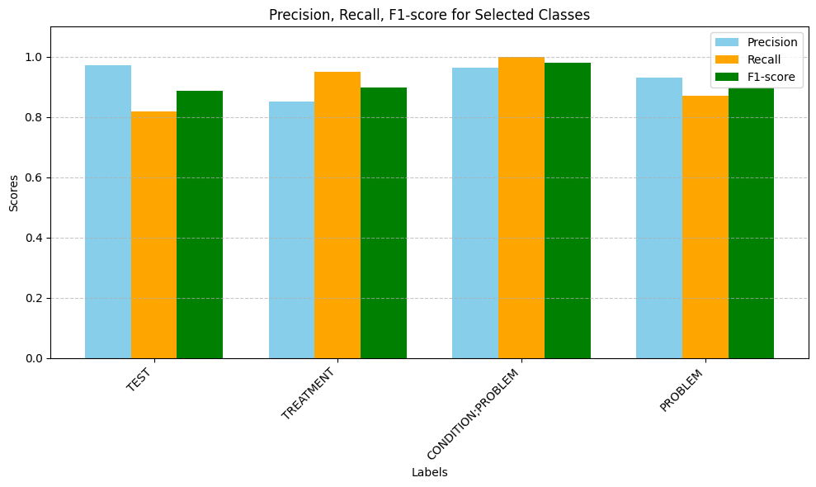
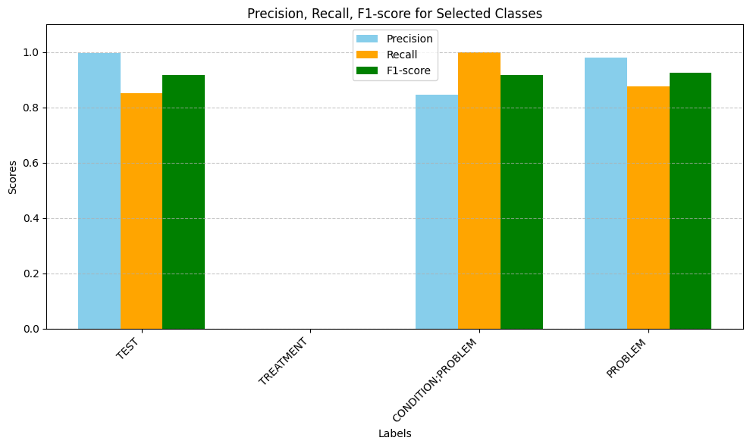
Experimental Results
Evaluation Metrics of Dataset 1 Evaluation Metrics of Dataset 2

Slide 27
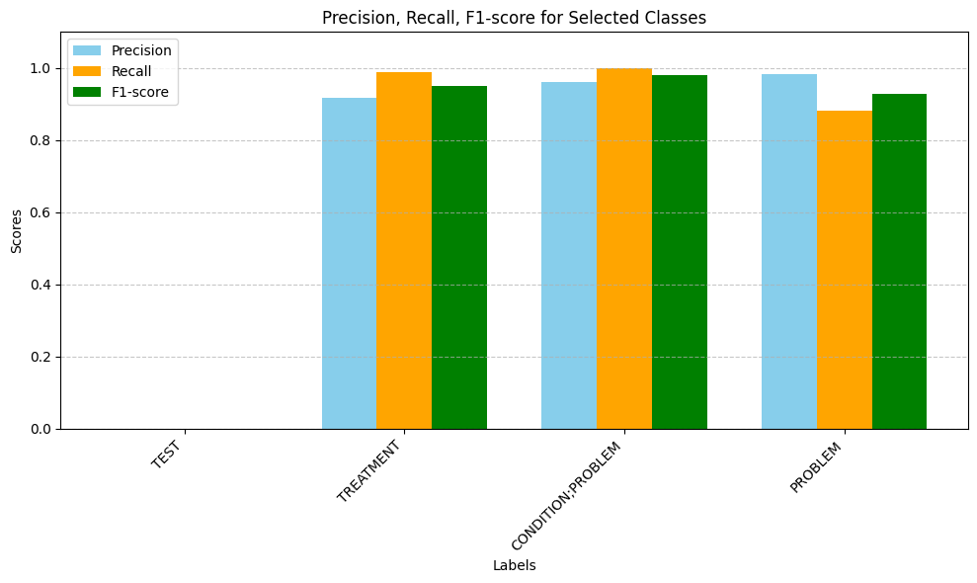
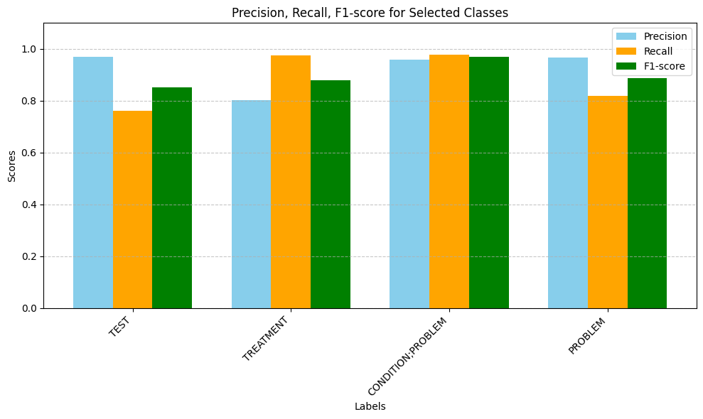
Experimental Results
Evaluation Metrics of Dataset 3 Evaluation Metrics of Dataset 4

Slide 28
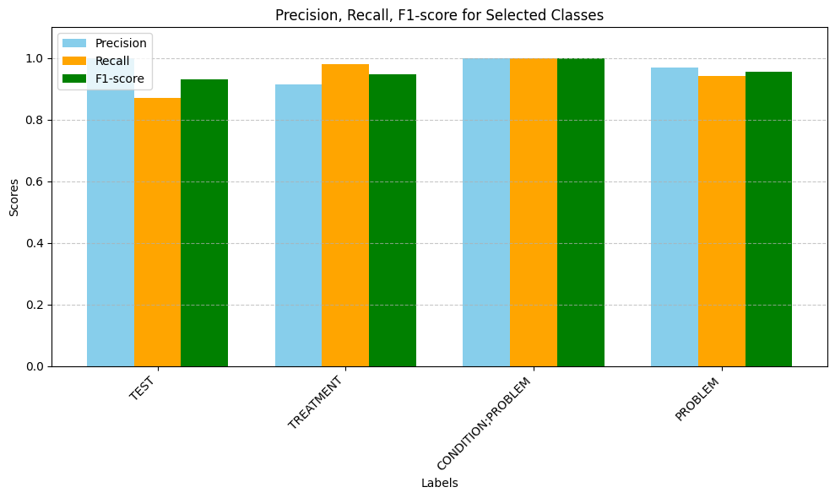
Experimental Results
Evaluation Metrics of Dataset 5

Slide 29
Experimental Results
Dataset | F1-Score | Precision | Recall
1 | 0.91 | 0.92 | 0.91
2 | 0.91 | 0.91 | 0.91
3 | 0.94 | 0.94 | 0.94
4 | 0.88 | 0.89 | 0.88
5 | 0.95 | 0.95 | 0.95
Average(1-5) | 0.921 | 0.932 | 0.921
Comparison of F1-Score, Precision, and Recall of 5 Datasets and their Average.

Slide 30
Comparison of the performance metrics of a few representative approaches datasets used.
Paper | Dataset | F1-Score | Precision | Recall
[16] | Dataset1 Dataset2 Dataset3 Dataset4 Dataset5 | 0.701 0.712 0.704 0.711 0.732 0.692 | 0.696 0.752 0.723 0.771 0.676 | 0.411 0.454 0.432 0.443 0.410
[20] | Dataset1 Dataset2 Dataset3 Dataset4 Dataset5 | 0.711 0.732 0.752 0.723 0.733 0.745 | 0.657 0.725 0.712 0.735 0.713 | 0.662 0.729 0.719 0.742 0.718
[21] | Dataset1 Dataset2 Dataset3 Dataset4 Dataset5 | 0.686 0.676 0.652 0.677 0.645 | 0.657 0.725 0.712 0.735 0.725 | 0.662 0.729 0.719 0.712 0.729

Slide 31

Conclusions
The proposed BiLSTM-NER with Runtime Context Identifier effectively automates structured information extraction from unstructured EHRs.
The model’s strong performance across heterogeneous datasets confirms its clinical applicability for real-time decision support.

Slide 32

Future Work
Future work will focus on enhancing preprocessing, augmenting data, and integrating domain knowledge to improve accuracy, generalizability, and interpretability in clinical settings.
Real-Time Deployment Application.
The unbalanced datasets can be used to review the changes in results.

Slide 33


Slide 34


Slide 35
REFERENCES
[1] L.E.K. Consulting: healthcare data projected between 2,300 and 10,800 exabytes by 2025.
[2] Study: Physicians spend ~35% of their time documenting patient data.
[3] In clinical NLP, deep learning (e.g. RNNs) outperform traditional models (like CRFs) in NER tasks.
[4] H. Ying and S. Yu, “A Question Answering Based Pipeline for Comprehensive Chinese EHR Information Extraction,” arXiv preprint arXiv:2402.11177, 2024, [Online]. Available: http://arxiv.org/abs/2402.11177
[5] S. Jain et al., “RadGraph: Extracting Clinical Entities and Relations from Radiology Reports,” CoRR, vol. abs/2106.14463, 2021, [Online]. Available: https://arxiv.org/abs/2106.14463.
[6] A. Dada, T. L. Ufer, M. Kim, and others, “Information extraction from weakly structured radiological reports with natural language queries,” Eur Radiol, vol. 34, pp. 330–337, 2024, doi: 10.1007/s00330-023-09977-3.

Slide 36
REFERENCES
[7] I. C. Wiest et al., “From Text to Tables: A Local Privacy Preserving Large Language Model for Structured Information Retrieval from Medical Documents,” medRxiv, 2023, doi: 10.1101/2023.12.07.23299648.
[8] D. Liu et al., “Evaluation of General Large Language Models in Contextually Assessing Semantic Concepts Extracted from Adult Critical Care Electronic Health Record Notes,” arXiv preprint arXiv:2401.13588, 2024, [Online]. Available: http://arxiv.org/abs/2401.13588
[9] S. Han et al., “Classifying social determinants of health from unstructured electronic health records using deep learning-based natural language processing,” J Biomed Inform, vol. 127, p. 103984, 2022, doi: 10.1016/j.jbi.2021.103984.
[10] J. Song and others, “Local–Global Memory Neural Network for Medication Prediction,” IEEE Trans Neural Netw Learn Syst, vol. 32, no. 4, pp. 1723–1736, 2021, doi: 10.1109/TNNLS.2020.2989364.
[11] H. J. Park, D. Y. Jung, W. Ji, and C.-M. Choi, “Detection of Bacteremia in Surgical InPatients Using Recurrent Neural Network Based on Time Series Records: Development and Validation Study,” J Med Internet Res, vol. 22, no. 8, p. e19512, 2020, doi: 10.2196/19512.
[12] J. Luo, M. Ye, C. Xiao, and F. Ma, “HiTANet: Hierarchical Time-Aware Attention Networks for Risk Prediction on Electronic Health Records,” in Proceedings of the 26th ACM SIGKDD International Conference on Knowledge Discovery & Data Mining, 2020.

